Slide 1
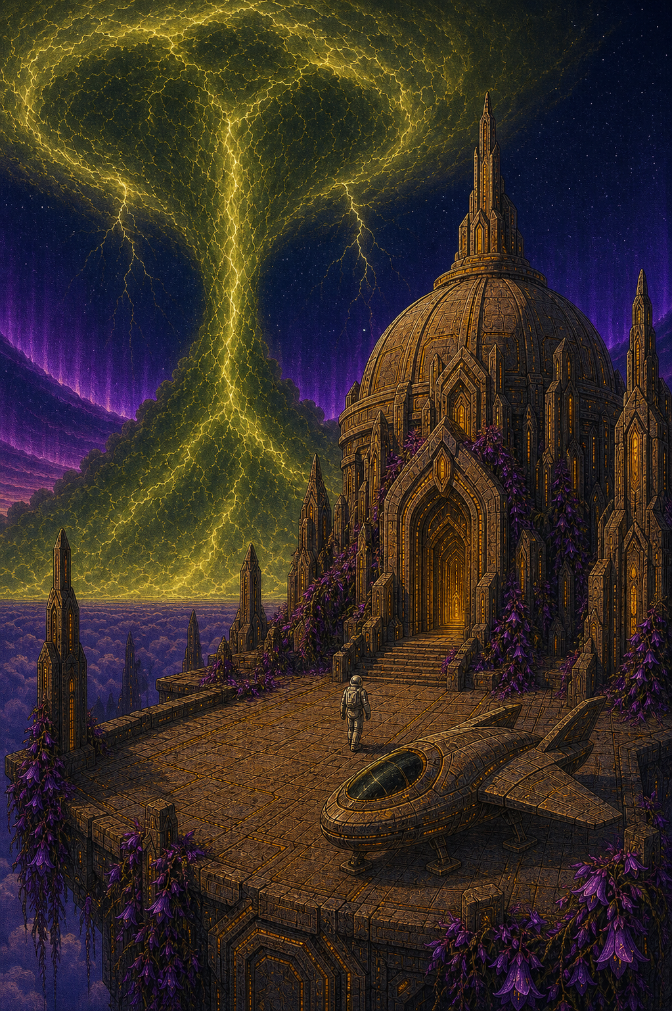
AI Engineer Agentic Track
The Complete
Agent & MCP
Course
Week 4
Day 2

Slide 2
Week 6: MCP
Agentic
Architecture
and MCP
Building an
MCP Server
and Client
Multiple Local
and Remote
MCP servers
Project 8: AI
Equity Traders
Project 8: AI
Equity Traders
In Action
Week 5: Agent Frameworks
Google ADK and A2A
AWS Strands Agents
Other Python Frameworks
JS/TS Frameworks
Project 7:
Agent
Loop
Week 4: LangGraph
LangChain Core
LangGraph
LangChain
create_agent
Deep Agents
Project 6:
Sidekick
Week 3: CrewAI
Understand
Crew AI
Concepts
Build a Crew
Agent
Project 4: Stock
Picker
Project 5:
Developer
Agent
Project 5:
Engineering
Team
Week 2: OpenAI Agents SDK
Understand
OpenAI Agents
SDK concepts
Project 2: an
SDR
Tools vs Agents
Guardrails
Project 3: Deep
Research
Project 3: Deep
Research app
Week 1: Foundations
Make an
Agentic
Workflow
Agents and
Agentic
Patterns
Orchestrating
LLMs
Autonomy and
Tools
Project 1:
Your personal
career agent

Slide 3
Recap: the abstraction layers
Four levels: control at the bottom, convenience at the top
Layer 4 Harness
Planning, sub agents, a filesystem; you supply intent
deepagents
Layer 3 Agent
The agent loop prebuilt; you supply model, tools and prompt
langchain
Layer 2 Orchestration
StateGraph, nodes, edges, checkpoints; you control the flow
langgraph
TODAY
Layer 1 Building blocks
Models, messages and tools; you control everything
langchain-core

Slide 4



Introducing LangGraph
Layer 2 of the stack: the bulletproof orchestration layer
LangGraph a low-level orchestration framework and runtime for stateful, long-running agents
Dependency graph you declare nodes that do the work and edges that say what depends on what
Durable state survives failures; a run can resume exactly where it was interrupted

Slide 5
Graphs, State, Nodes, Edges
Agent Workflows are represented as graphs
State represents the current snapshot of the application.
Node
Edge
Edge
Node
Node
Nodes do the work.
Edges choose what to do next.

Slide 6




Your code carries out 5 steps..
..before you even run your agents
Define the State class
Start the Graph Builder
Create a Node
Create Edges
Compile the Graph

Slide 7
More on the State
State is immutable:
def my_counting_node(old_state: State) -> State:
count = old_state.count
count += 1
new_state = State(count=count)
return new_state
For each field in your State, you can specify a
special function called a reducer
When you return a new State, LangGraph uses the
reducer to combine this field with existing State
This enables LangGraph to run multiple nodes
concurrently and combine State without overwriting

Slide 8
The tool loop
ToolNode runs the tools; tools_condition routes the flow
START
chatbot
wants a tool
tools
ToolMessage results
done
END
bind_tools gives the model its options
tools_condition routes: another tool call, or finish
ToolNode runs the calls and feeds results back to the model

Slide 9
Observability with LangSmith
Four lines in .env and every run is traced
Set up sign up at smith.langchain.com, add your API key and some constants to .env per the screens (rerun load_dotenv)
Every run traced each model call, tool call, token and latency, with no code changes
Debug visually see exactly which nodes ran, in what order, with inputs and outputs
Free to start the Developer tier includes 5k traces a month

Slide 10
The Super-Step
"A super-step can be considered a single iteration
over the graph nodes. Nodes that run in parallel are
part of the same super-step, while nodes that run
sequentially belong to separate super-steps."
One graph.invoke() call is one run: a sequence of super-steps, one per layer of nodes
just like one Runner.run() in the OpenAI Agents SDK
Each successive LLM call is one super-step; if it requests multiple tool calls, they run in the next super-step
Reducers merge updates within a run; the checkpointer carries State between runs

Slide 11
How it all fits together
Define
Graph
active nodes run in parallel
reducers merge updates into State
Super-step
active nodes run in parallel
reducers merge updates into State
Super-step
active nodes run in parallel
reducers merge updates into State
Super-step

Slide 12
Checkpointing
Define
Graph
a checkpoint after every super-step
active nodes run in parallel
reducers merge updates into State
Super-step
active nodes run in parallel
reducers merge updates into State
Super-step
active nodes run in parallel
reducers merge updates into State
Super-step

Slide 13
Memory and time travel
A checkpointer saves a snapshot after every super-step
MemorySaver keeps checkpoints in memory; gone on restart
SqliteSaver writes them to a file that survives restarts
thread_id the config key that files and reloads a conversation
get_state and get_state_history inspect every snapshot
Time travel rerun the graph from any earlier checkpoint_id

Slide 14
Week 6: MCP
Agentic
Architecture
and MCP
Building an
MCP Server
and Client
Multiple Local
and Remote
MCP servers
Project 8: AI
Equity Traders
Project 8: AI
Equity Traders
In Action
Week 5: Agent Frameworks
Google ADK and A2A
AWS Strands Agents
Other Python Frameworks
JS/TS Frameworks
Project 7:
Agent
Loop
Week 4: LangGraph
LangChain Core
LangGraph
LangChain
create_agent
Deep Agents
Project 6:
Sidekick
Week 3: CrewAI
Understand
Crew AI
Concepts
Build a Crew
Agent
Project 4: Stock
Picker
Project 5:
Developer
Agent
Project 5:
Engineering
Team
Week 2: OpenAI Agents SDK
Understand
OpenAI Agents
SDK concepts
Project 2: an
SDR
Tools vs Agents
Guardrails
Project 3: Deep
Research
Project 3: Deep
Research app
Week 1: Foundations
Make an
Agentic
Workflow
Agents and
Agentic
Patterns
Orchestrating
LLMs
Autonomy and
Tools
Project 1:
Your personal
career agent

Slide 15

AI Engineer Agentic Track
The Complete
Agent & MCP
Course
57%
Complete

